Slide 1

Deep Neural Network: Autoencoders
Mina Farmanbar
Associate Professor, University of Stavanger
for engineers

Slide 2
Autoencoders
Autoencoding is a data compression algorithm where the compression and the decompression functions are learned automatically from data.
Autoencoders are data specific.
which means that they will only be able to compress data similar to what they have been trained on.

Slide 3
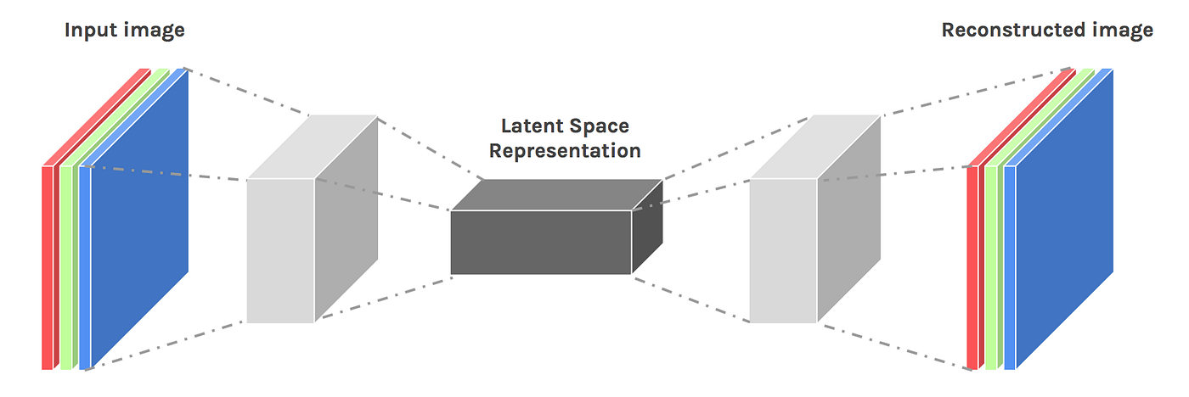
Autoencoders
Encoder
Bottleneck
Decoder
https://miro.medium.com/v2/resize:fit:1200/1*TOJD69Y8dZsKFEW-21xUPg.png

Slide 4
Autoencoders
Autoencoder is an unsupervised neural network model
Interesting applications of autoencoders:
Data denoising
Dimensionality reduction for data visualization
Image reconstruction
Image generation

Slide 5

Autoencoders
We can define reconstruction loss as something like MSE(x, x’) if the inputs are real values.
The dimensionality of z is usually less than x, that’s why autoencoders in deep learning are also called bottleneck neural networks.

Slide 6
Autoencoders
Autoencoders are just like Principal Component Analysis (PCA) which is itself a dimensionality reduction algorithm…
PCA is linear in nature whereas autoencoders in deep learning are non-linear in nature due to neural net-based architecture.

Slide 7
Restricted Boltzmann Machines or (RBMs)
A very popular type of autoencoders is the Restricted Boltzmann Machines or (RBMs).
Applications include:
Fixing imbalanced datasets
Estimating missing values
Automatic feature extraction

Slide 8
Thank you!
Mina Farmanbar
mina.farmanbar@uis.no

